Slide 1
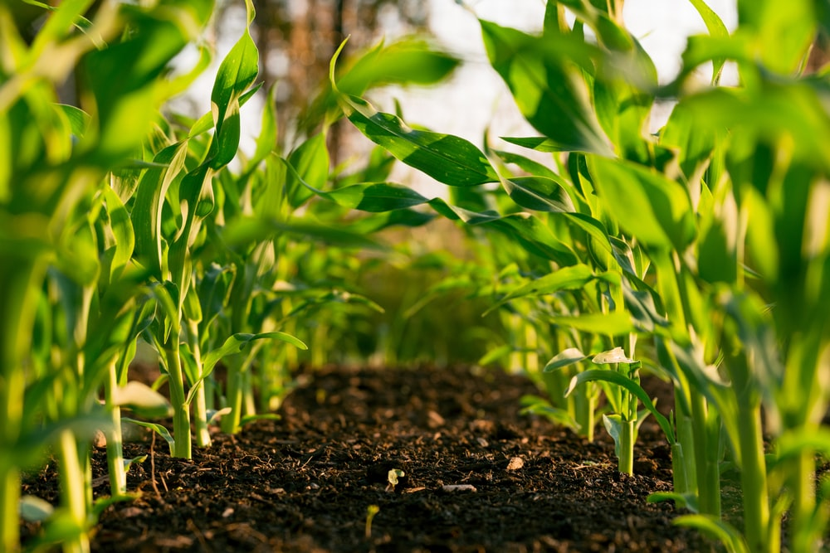
Our Agriculture

Slide 2
Agriculture Production
Our total agriculture production has increased since Independence. This is due to the following factors.
Use of better quality seeds.
More area has been brought under irrigation.
Use of fertilizers and pesticides.
Use of tractors and other modern agriculture machinery.

Slide 3
Food Crop The crop that grown to be eaten are called Food crop Examples of food crops
Types of crops
The crops grown are of two types- Food crop and cash crop

Slide 4
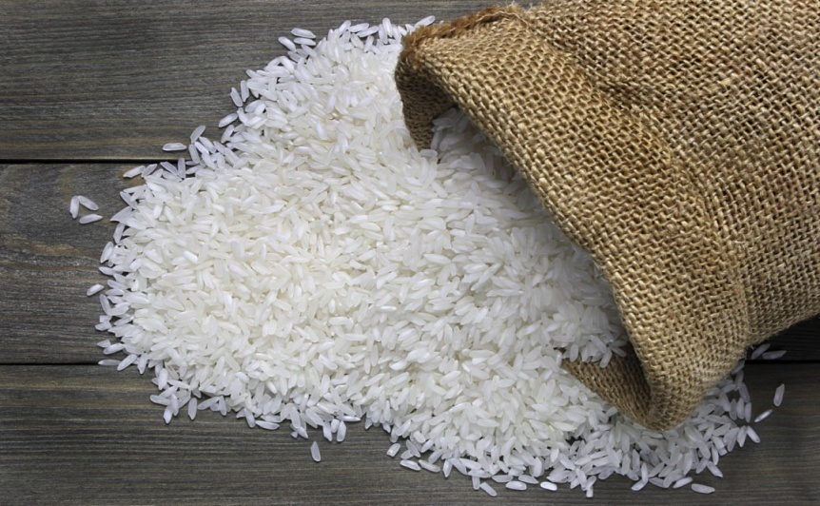
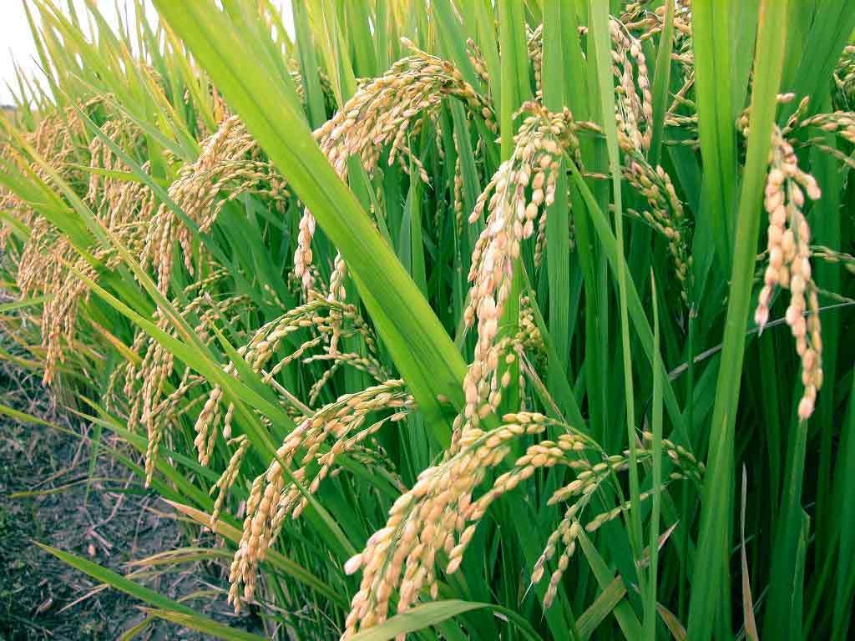
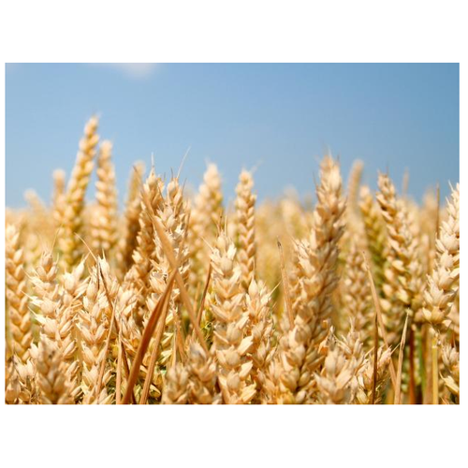
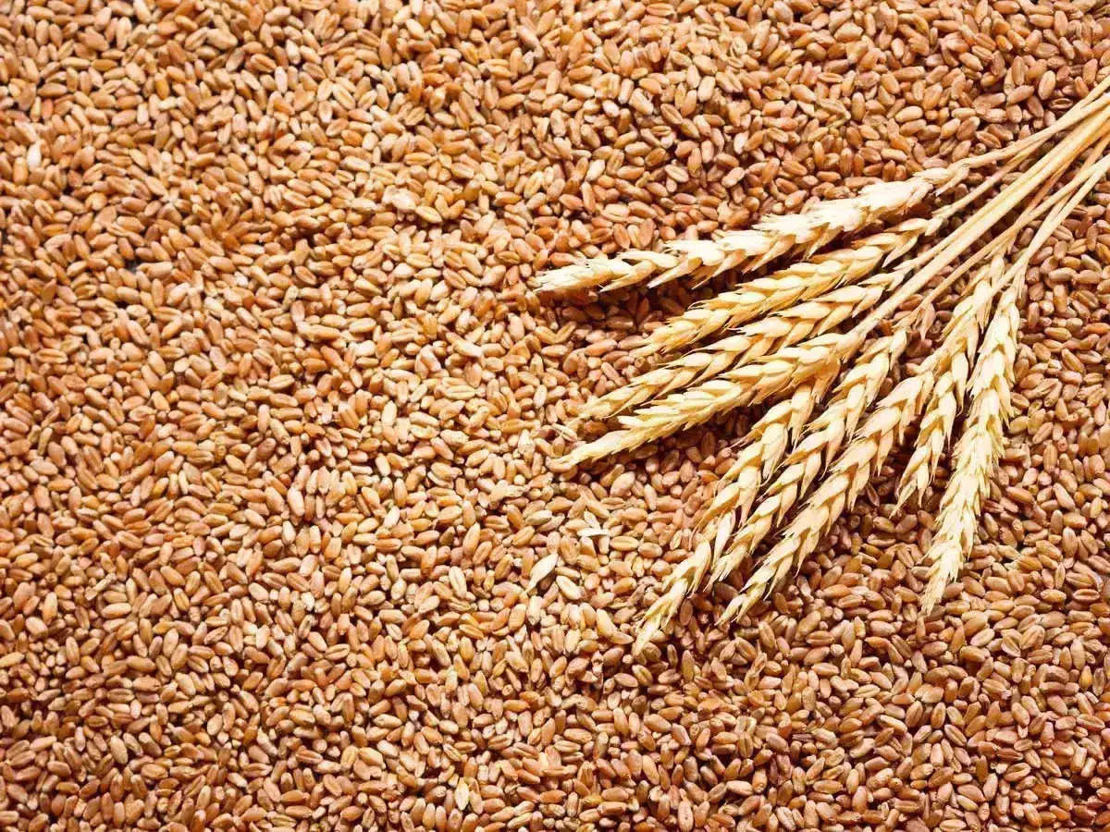
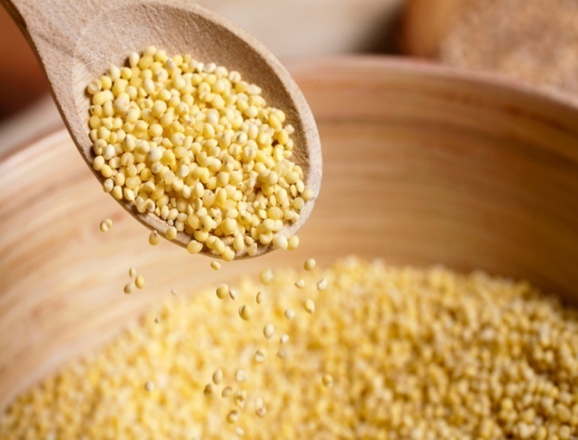
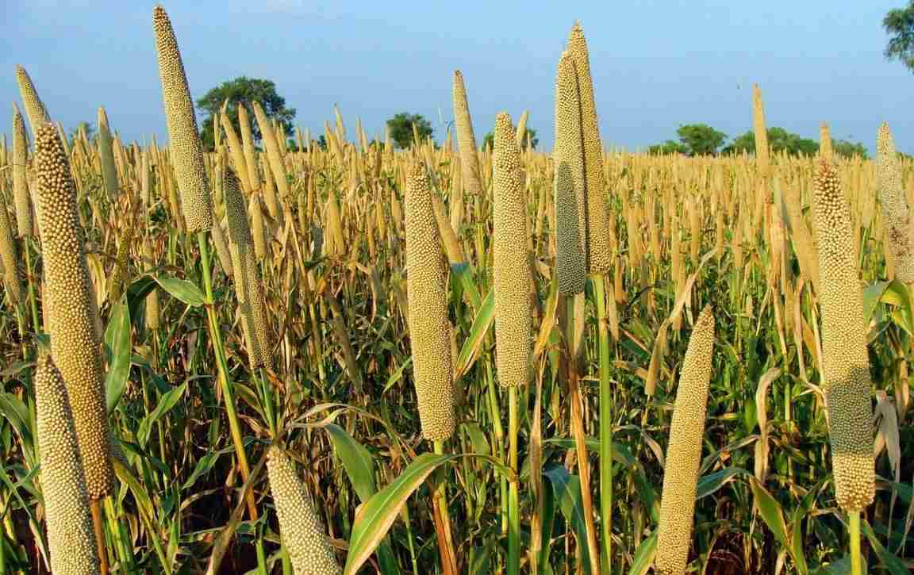
1.Rice
2. Wheat
3.Millet

Slide 5
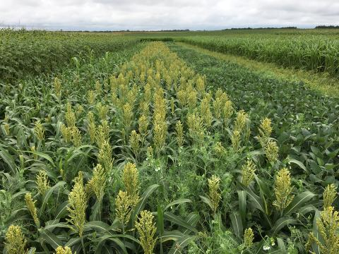
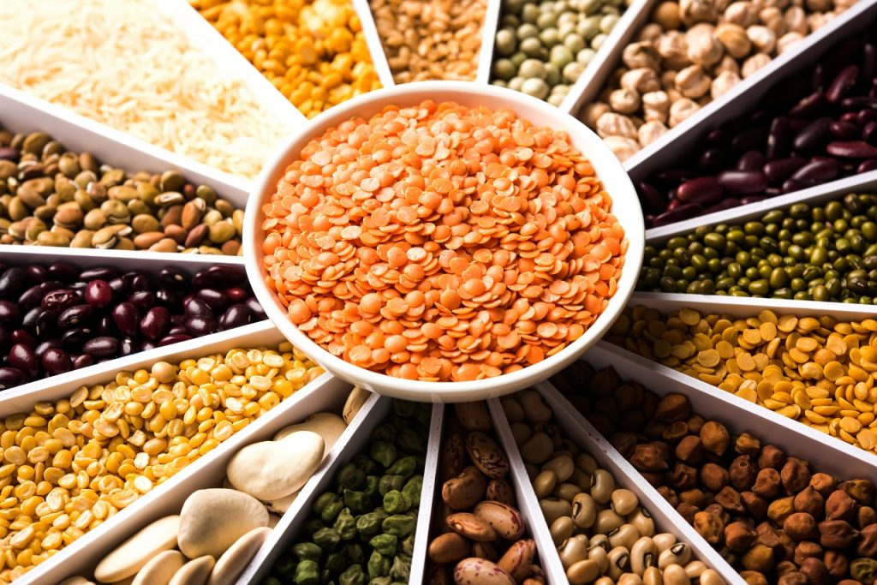
4.Pulses
Cash crops
The crops that grown to be used in industries or sale in market are called Cash crops.

Slide 6
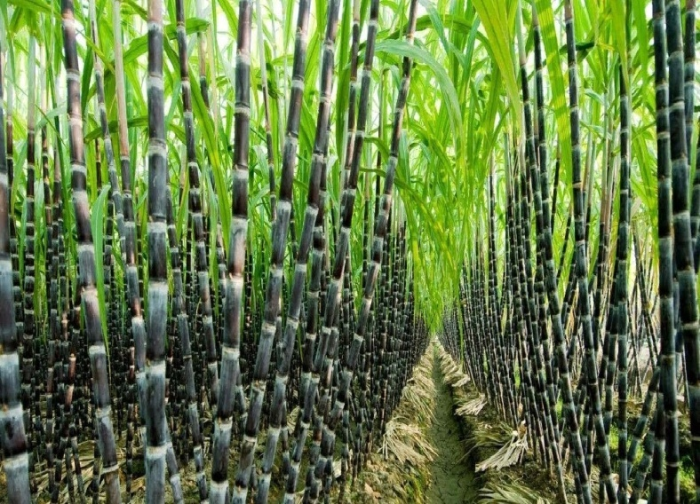
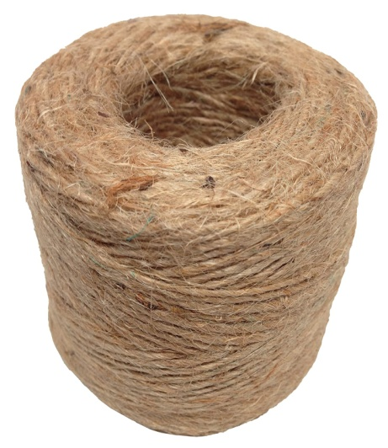
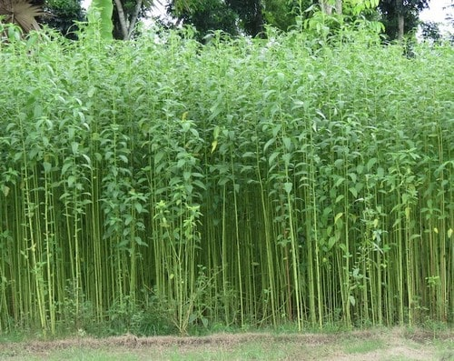
The main cash crops are
Sugarcane
2. Jute

Slide 7
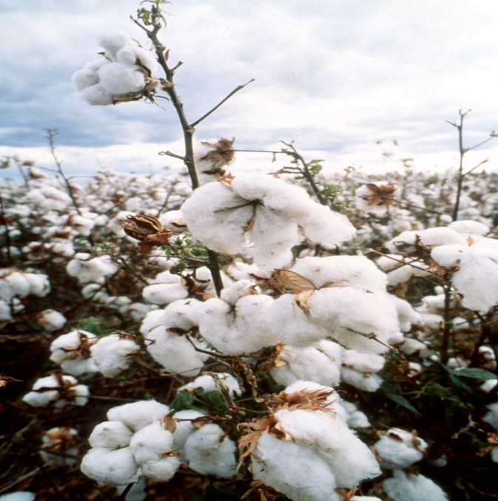
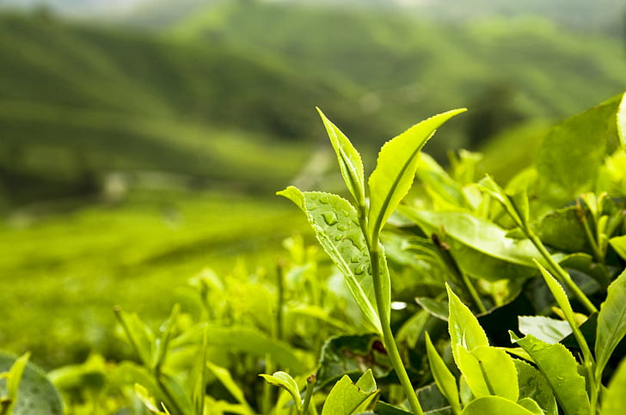
3. cotton
4. Tea

Slide 8
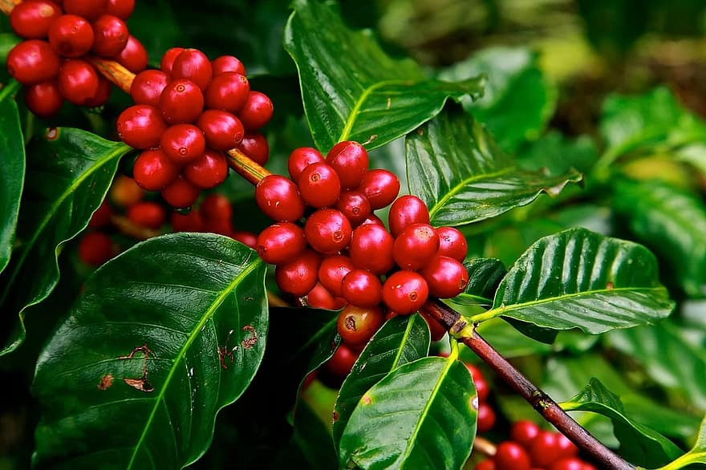
5. Coffee
Horticulture
The cultivation of fruits, flowers and vegetables are called horticulture. They are grown to sale in market. Many horticulture crops grown in India.

Slide 9
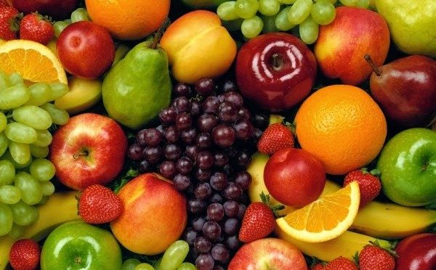
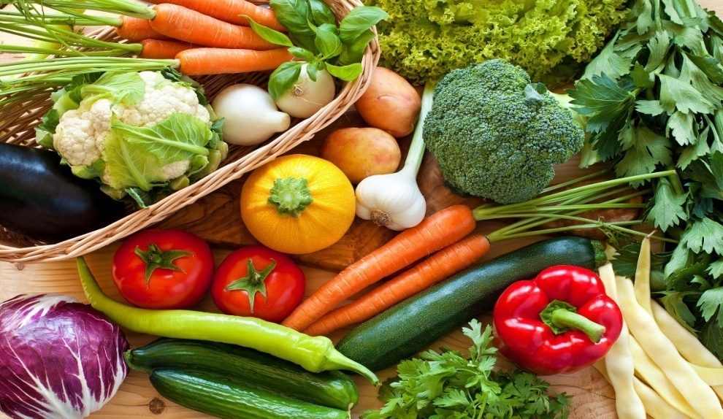
Examples of Horticulture 1. Fruits
2. Vegeatbles

Slide 10
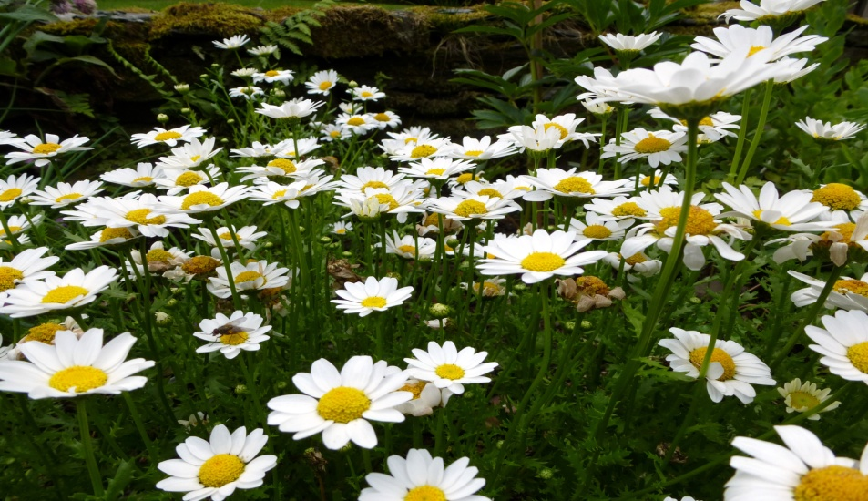
3. Flowers
Livestock Rearing
Animals which farmers keep for their use are called livestock rearing.

Slide 11
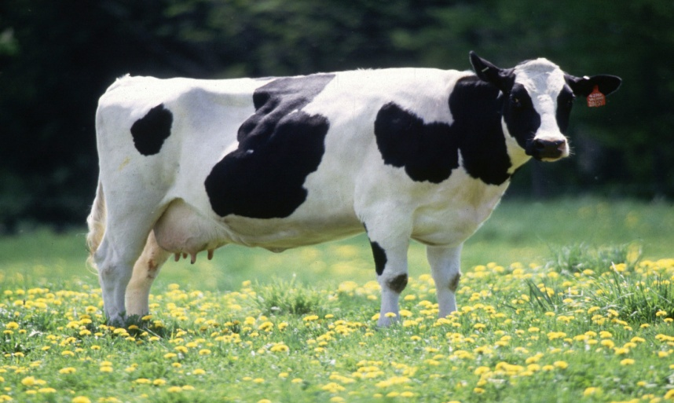
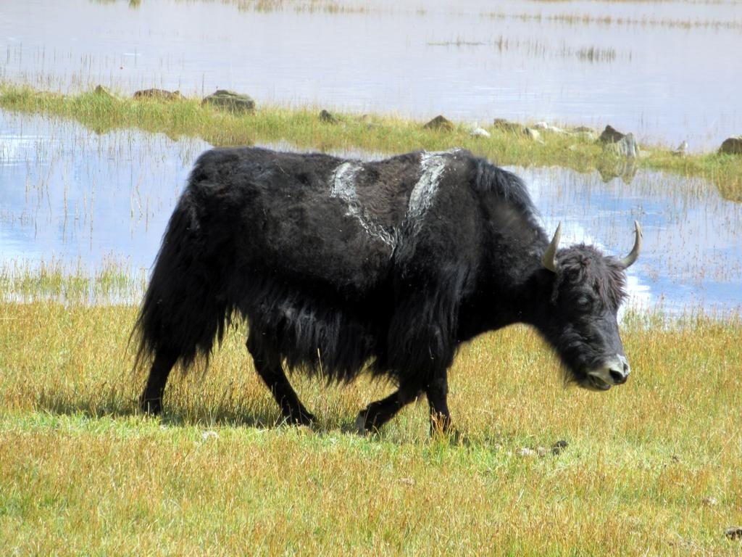
Examples of livestock rearing animals 1. Cow
2. Yak

Slide 12
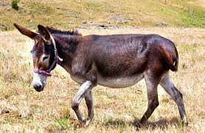
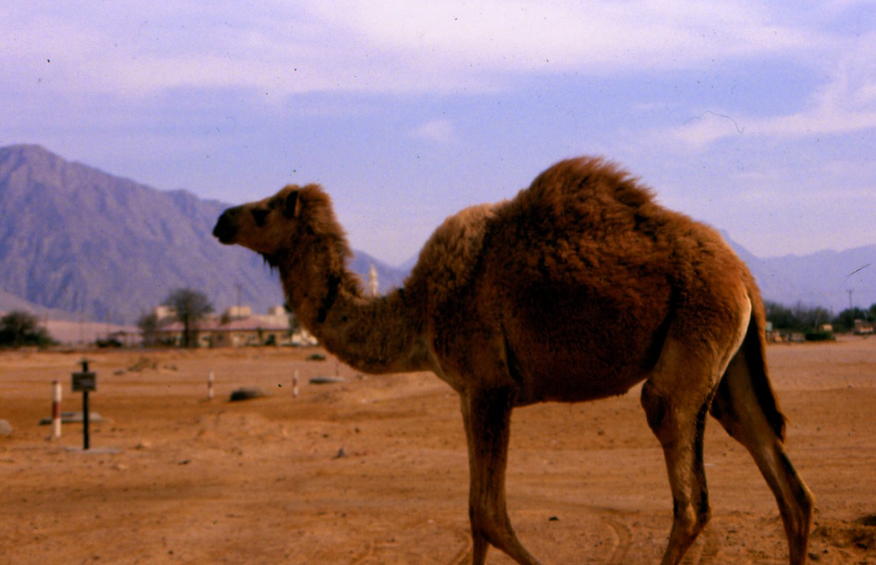
3. Mule
4. Camel

Slide 13
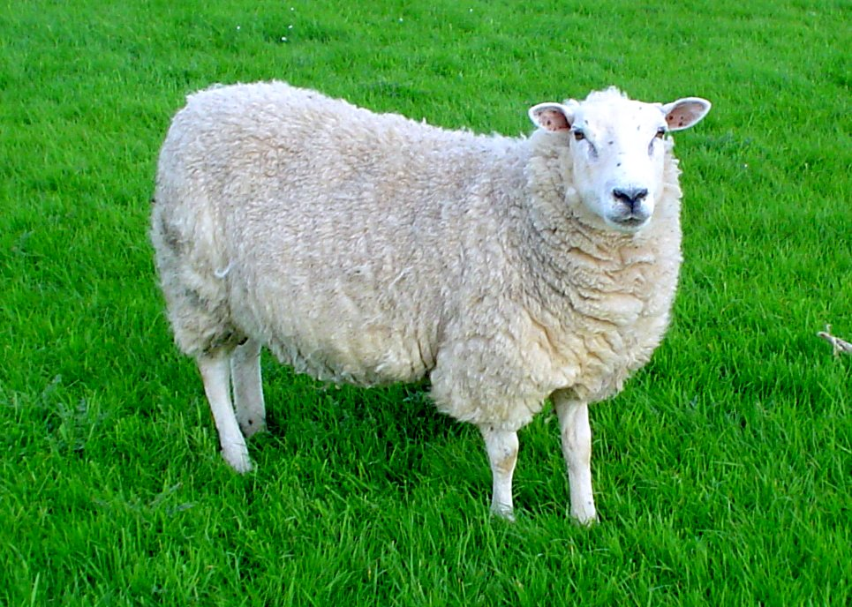
5. Sheep
Fishing
Fishing is of two types marine and inland fishing. Catching fish from the sea is called marine fishing.

Slide 14
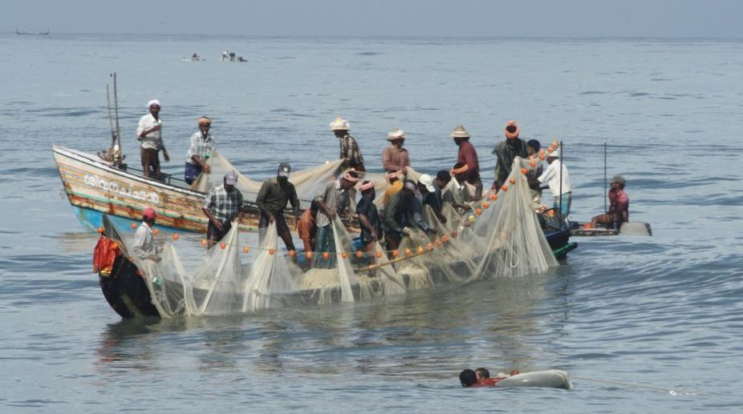
Marine Fishing
It is done in the states located along the coast sardine, mackerels and shrimp from the sea. Catching fish from rivers, canals, lakes, and ponds are called inland fishing.

Slide 15
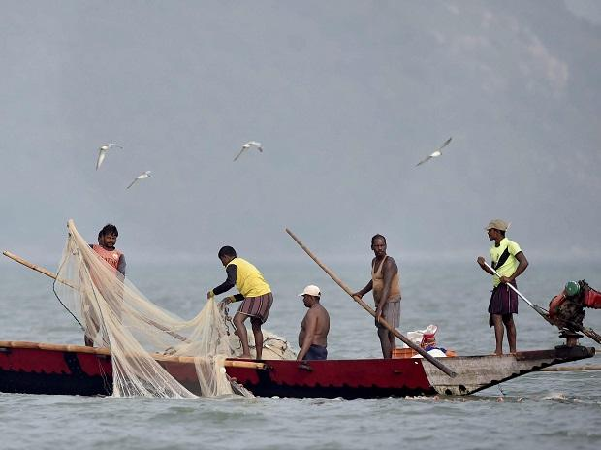
Inland fishing
It is popular in Andhra pradesh, Chhatisgrah, West bengal, Assam and Himachal pradesh.

